Slide 1

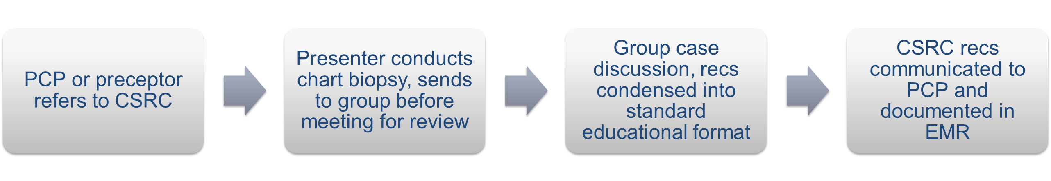
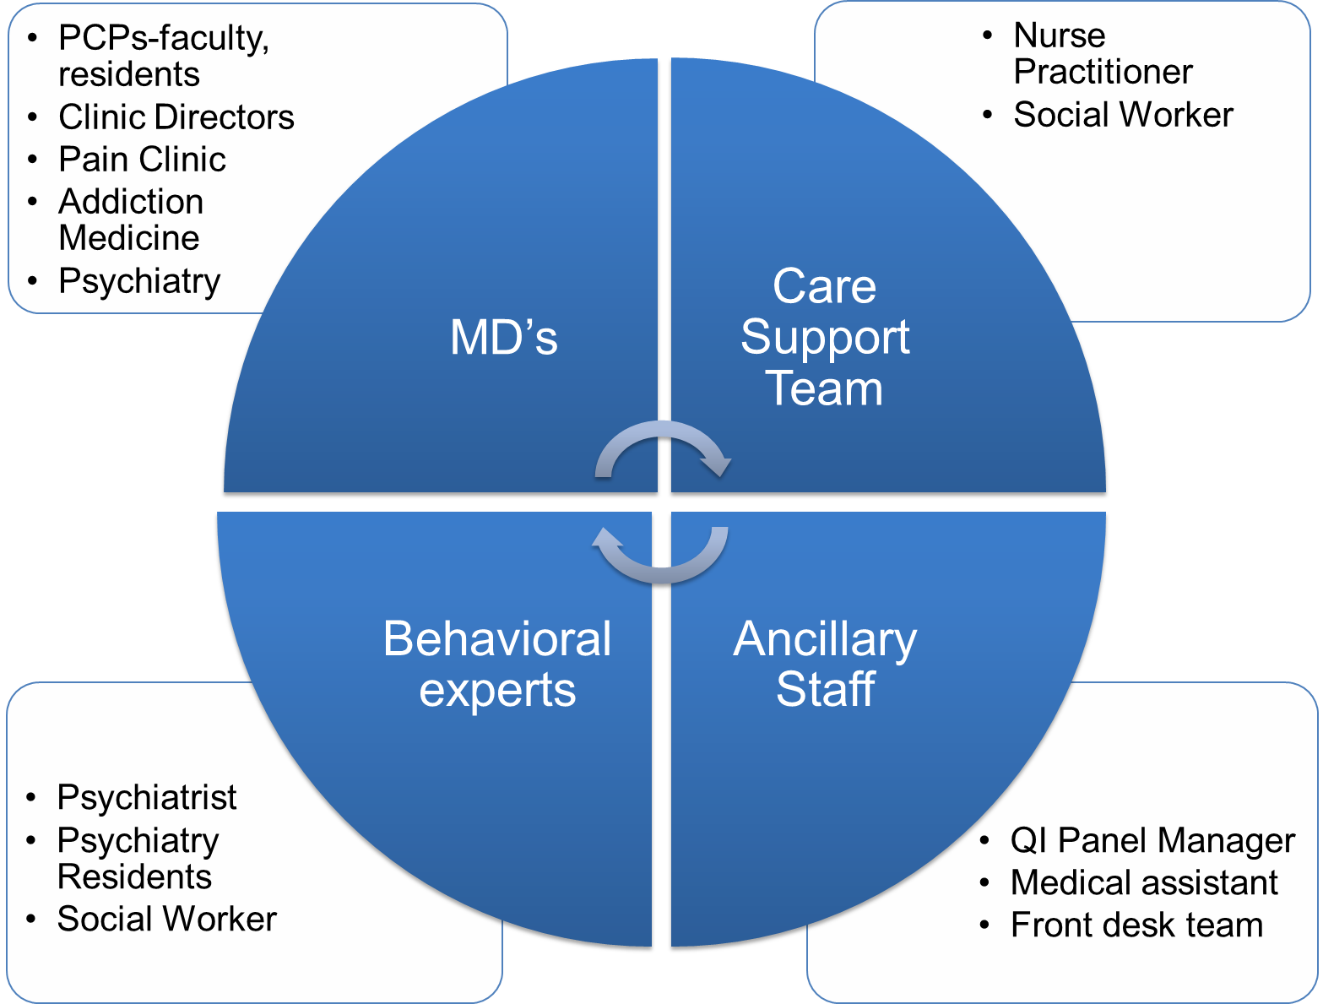

Now what do I do?! Improving controlled substance prescribing practices one case review at a time
Irina Kryzhanovskaya¹, MD; Maria Wamsley¹, MD; Miranda Dunlop¹, MD; Maki Aoki¹, MD; Jennifer Morrish¹; Tim Anderson¹; Jenny Wong¹; Emma Samelson-Jones^{1,2}, MD; Rosemary Lam¹; Scott Steiger³, MD
¹Division of General Internal Medicine, University of California, San Francisco; ²Department of Psychiatry, University of California, San Francisco, ³Division of General Internal Medicine, Zuckerberg San Francisco General Hospital
Background
PCPs at two General Medicine clinics within the UCSF Division of General Internal Medicine (DGIM) prescribe chronic opioids for non-cancer related pain for over 600 patients
Review committees are recommended by the CDC for improving the care of patients on chronic opioids
Beginning February 2014, the Controlled Substance Review Committee (CSRC) has met monthly to review challenging cases of patients on controlled substances
CSRC Process
Results: safer prescribing
Outcomes as of 3/2018 | # patients
Total reviewed 2017-2018 | 14
Attending | 8
Resident | 6
PCP prescribes lower dose | 8
PCP gave new Rx for Naloxone | 8
PCP no longer prescribing opioids | 6
Patient referred for treatment of opioid use disorder | 4
Patient referred to mental health resources | 9
Sample referral
*
35M h/o ESRD on HD, severe mixed connective tissue disease, inflammatory arthritis, and anxiety, prescribed opioids and benzos, what to do with controlled substance regimen in setting of toxicology positive for cocaine and negative for prescribed substances?
We are a multidisciplinary team
Chart Biopsy template
Example of Recommendations
PMD’s question(s) for the CSRC:
Pain diagnosis, history, and tracking methods:
Specialist referrals/visits:
Pain Medications, current regimen:
Pain medication, historical regimen(s):
Adjunctive treatment history:
Psychiatric history:
Trauma history:
History of violent or aggressive behavior?
Substance use/substance use treatment history:
Home life/social support:
Urine Toxicology results:
CURES report:
High-risk behaviors:
We recommend contacting lab medicine about the characteristics and variance of urine toxicology testing in patients with ESRD
In light of the toxicology results and the patient’s pattern of controlled substance use, we support a benzodiazepine taper as you treat his anxiety with other medications
We recommend mid-prescription nurse visits or coordination with Nephrology during HD for pill counts or repeat urine toxicology
Given the patient’s report of lack of benefit from Methadone, we recommend stopping it as it’s not helping and there is concern for diversion.
For a safer option to treat his pain, consider switching to Buprenorphine and/or adding Lidocaine gel/patches as adjuncts
Consider discussing patient transplant candidacy as an incentive to remain off of cocaine and partnering with Nephrology to connect patient to pre-transplant support groups and substance cessation programs
We applaud your efforts to meet the patient where he is and refer him to the mental health resources available in clinic (embedded psychiatry, therapy).
We recommend linking the patient with his local IHSS support team for further assistance at home.
Lessons learned
Multidisciplinary review allows for richer discussion and up to date recommendations based on best practices
Monthly case review highlights areas for improvement in controlled substance prescribing and OUD treatment in DGIM
Clinic leadership presence provides impetus for policy review and standardization
Agreement by consensus on standard location and manual entry of recommendations in the EMR
Next steps
Increase resident and staff (MA, LVN, RN, NP, Pharmacy) participation in the committee
Increase provider awareness of this resource
Increase availability and awareness of OUD treatment options in clinic
Create dedicated CSRC referrals within EMR
*

